Slide 1


Built-in Functions
Other Functions and Wildcards in SQL Server
SoftUni Team
Technical Trainers
Software University
https://softuni.bg

Slide 2
Table of Contents
Date Functions
Other Useful Functions
Wildcards
2

Slide 3

GETDATE, DATEDIFF, DATEPART, Etc.

Slide 4
Date Functions (1)
DATEPART – extract a segment from a date as an integer
Part can be any part and format of date or time
For a full list, take a look at the official documentation
DATEPART(Part, Date)
year, yyyy, yy
YEAR(Date)
month, mm, m
MONTH(Date)
day, dd, d
DAY(Date)

Slide 5
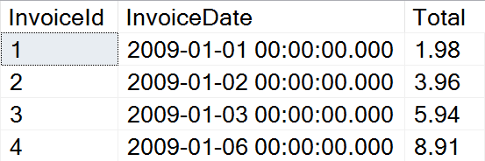
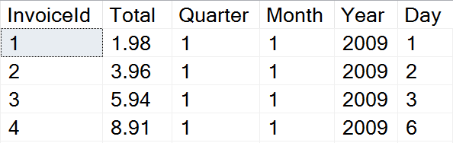
Problem: Quarterly Report
Prepare sales data for aggregation by displaying yearly quarter, month, year and day of sale

Slide 6
Solution: Quarterly Report
Use DATEPART to get the relevant parts of the date
This statement might be useful as a View
SELECT InvoiceId, Total,
DATEPART(QUARTER, InvoiceDate) AS Quarter,
DATEPART(MONTH, InvoiceDate) AS Month,
DATEPART(YEAR, InvoiceDate) AS Year,
DATEPART(DAY, InvoiceDate) AS Day
FROM Invoice

Slide 7
Date Functions (2)
DATEDIFF – finds the difference between two dates
Part can be any part and format of date or time
Example: Show employee experience
DATEDIFF(Part, FirstDate, SecondDate)
SELECT ID, FirstName, LastName,
DATEDIFF(YEAR, HireDate, '2017/01/25')
AS [Years In Service]
FROM Employees

Slide 8
Date Functions (3)
DATENAME – gets a string representation of a date's part
DATEADD – performs date arithmetic
Part can be any part and format of date or time
GETDATE – obtains the current date and time
EOMONTH – returns the last day of the month
DATENAME(Part, Date)
SELECT DATENAME(weekday, '2017/01/27')
DATEADD(Part, Number, Date)
SELECT GETDATE()

Slide 9


Other Functions
CAST, CONVERT, OFFSET, FETCH

Slide 10
Other Functions (1)
CAST & CONVERT – conversion between data types
ISNULL – swaps NULL values with a specified default value
Example: Display “Not Finished” for projects with no EndDate
CAST(Data AS NewType)
CONVERT(NewType, Data)
ISNULL(Data, DefaultValue)
SELECT ProjectID, Name,
ISNULL(CAST(EndDate AS varchar), 'Not Finished')
FROM Projects

Slide 11
Other Functions (2)
COALESCE – evaluates the arguments in order and returns the current value of the first expression that initially does not evaluate to NULL
SELECT COALESCE(NULL, NULL, 'third_value', 'fourth_value');
// third_value

Slide 12
Other Functions (3)
OFFSET & FETCH – get only specific rows from the result set
Used in combination with ORDER BY for pagination
SELECT ID, FirstName, LastName
FROM Employees
ORDER BY ID
OFFSET 10 ROWS
FETCH NEXT 5 ROWS ONLY
Rows to skip
Rows to include

Slide 13
Ranking Functions
ROW_NUMBER – always generate unique values without any gaps, even if there are ties
RANK – can have gaps in its sequence and when values are the same, they get the same rank
DENSE_RANK – returns the same rank for ties, but it doesn’t have any gaps in the sequence
NTILE – Distributes the rows in an ordered partition into a specified number of groups

Slide 14

Wildcards
Selecting Results by Partial Match

Slide 15
Using WHERE … LIKE
Wildcards are used with WHERE for partial filtration
Similar to Regular Expressions, but less capable
Example: Find all employees who's first name starts with "Ro"
SELECT ID, FirstName, LastName
FROM Employees
WHERE FirstName LIKE 'Ro%'
Wildcard symbol

Slide 16
Wildcard Characters
Supported characters include:
ESCAPE – specify a prefix to treat special characters as normal
% -- any string, including zero-length
_ -- any single character
[…] -- any character within range
[^…] -- any character not in the range
SELECT ID, Name
FROM Tracks
WHERE Name LIKE '%max!%' ESCAPE '!'

Slide 17

Summary
…
…
…
Date functions - DATEPART, DATEDIFF, GETDATE, etc.
Using Wildcards, we can obtain results by partial string matches

Slide 18
Questions?
Notes:
18

Slide 19

License
This course (slides, examples, demos, exercises, homework, documents, videos and other assets) is copyrighted content
Unauthorized copy, reproduction or use is illegal
© SoftUni – https://softuni.org
© Software University – https://softuni.bg
Notes:
19

Slide 20
Trainings @ Software University (SoftUni)
Software University – High-Quality Education, Profession and Job for Software Developers
softuni.bg, softuni.org
Software University Foundation
softuni.foundation
Software University @ Facebook
facebook.com/SoftwareUniversity
Software University Forums
forum.softuni.bg
20
Notes:
20

